Slide 1
Luke 4:14-21
¹⁴Jesus returned to Galilee in the power of the Spirit, and news about him spread through the whole countryside. ¹⁵He taught in their synagogues, and everyone praised him.
¹⁶He went to Nazareth, where he had been brought up, and on the Sabbath day he went into the synagogue, as was his custom. And he stood up to read. ¹⁷The scroll of the prophet Isaiah was handed to him. Unrolling it, he found the place where it is written:

Slide 2
Luke 4:14-24
¹⁸“The Spirit of the Lord is on me,
because he has anointed me
to preach good news to the poor.
He has sent me to proclaim freedom for the prisoners and recovery of sight for the blind,
to release the oppressed,
¹⁹ to proclaim the year of the Lord’s favour.”

Slide 3
Luke 4:14-24
²⁰Then he rolled up the scroll, gave it back to the attendant and sat down. The eyes of everyone in the synagogue were fastened on him, ²¹and he began by saying to them, “Today this scripture is fulfilled in your hearing.”

Slide 4
Looking Back Living Forward
Lessons for today, learned from Old Testament Prophets
Continuing the Prophetic Legacy – Peter Keep
LUKE 4:14-21

Slide 5
LOOKING BACK LIVING FORWARD: Continuing the prophetic legacy
Jerusalem, Jerusalem, you who kill the prophets and stone those sent to you, how often I have longed to gather your children together, as a hen gathers her chicks under her wings, and you were not willing.
[MATTHEW 23:37 & LUKE 13:34]
Image by Walkerssk on Pixabay

Slide 6
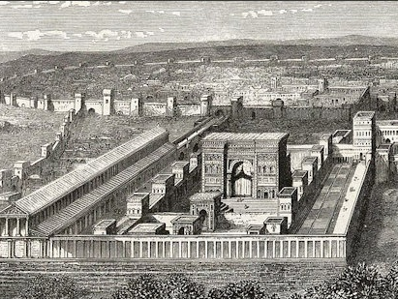
LOOKING BACK LIVING FORWARD: Continuing the prophetic legacy
Jerusalem, Jerusalem, you who kill the prophets and stone those sent to you, how often I have longed to gather your children together, as a hen gathers her chicks under her wings, and you were not willing.
[MATTHEW 23:37 & LUKE 13:34]

Slide 7
LOOKING BACK LIVING FORWARD: Continuing the prophetic legacy
JESUS (GOD):
sent the prophets
JERUSALEM (ISRAEL):
did not listen
[MATTHEW 23:37 & LUKE 13:34]

Slide 8
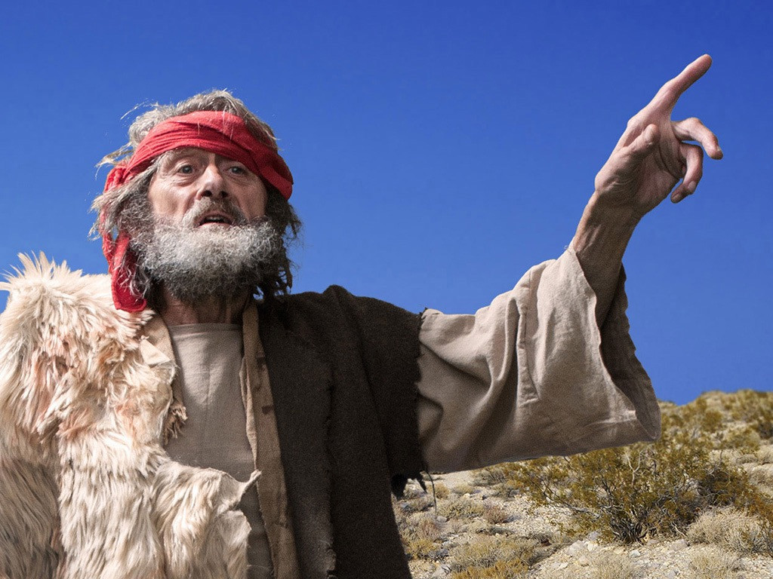
LOOKING BACK LIVING FORWARD: Continuing the prophetic legacy
PROPHETS:
often had hard lives
killed, stoned, rejected
[MATTHEW 23:37 & LUKE 13:34]
PICTURE OF ELIJAH from FREE BIBLE IMAGES

Slide 9
LOOKING BACK LIVING FORWARD: Continuing the prophetic legacy
PROPHETS:
some wrote
4 Major Prophets
12 Minor Prophets
others did not
some remain unknown e.g 1 Kings 13:1-34
PICTURE OF ELIJAH from FREE BIBLE IMAGES

Slide 10
LOOKING BACK LIVING FORWARD: Continuing the prophetic legacy
PROPHETIC ELEMENTS:
FORETELLING
- predicting
FORTHTELLING
- preaching
PICTURE OF ELIJAH from FREE BIBLE IMAGES

Slide 11
LOOKING BACK LIVING FORWARD: Continuing the prophetic legacy
PROPHETIC ELEMENTS
FORTHTELLING
and FORETELLING
FORETELLING
FORETELLING
IMMEDIATE
LONG TERM
MEDIUM TERM
TO INDIVIDUALS, JUDAH, ISREAL, JUDAH & ISRAEL, NATIONS
- challenging to interpret -

Slide 12
LOOKING BACK LIVING FORWARD: Continuing the prophetic legacy
PROPHETS did not always understand the prophecy
… the prophets, who spoke of the grace that was to come to you, searched intently and with the greatest care, trying to find out the time and circumstances to which the Spirit of Christ in them was pointing when he predicted the sufferings of the Messiah and the glories that would follow. It was revealed to them that they were not serving themselves but you, when they spoke of the things that have now been told you by those who have preached the gospel to you by the Holy Spirit sent from heaven.
[1 PETER 1:10-12]
FORETELLING
LONG TERM

Slide 13
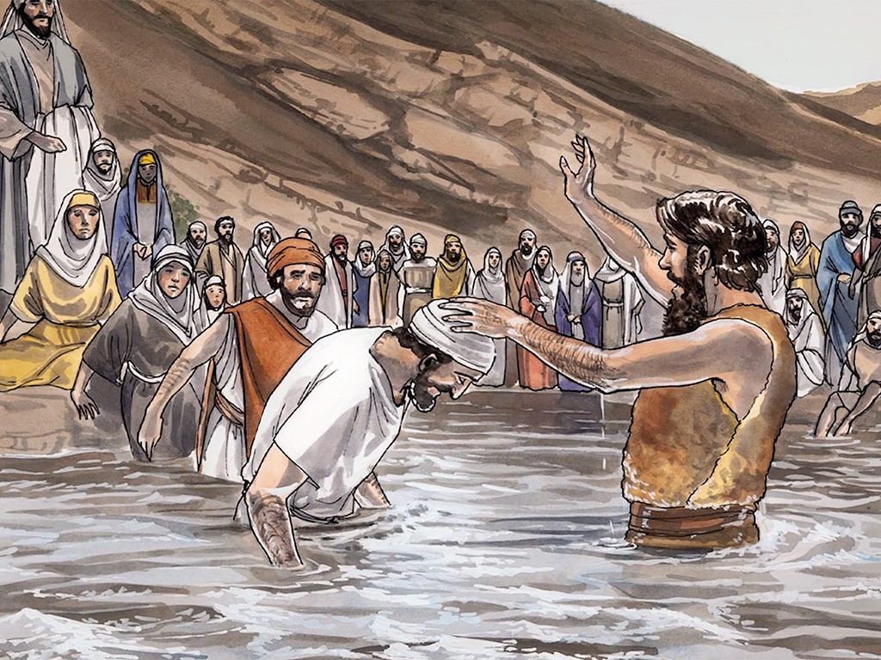
LOOKING BACK LIVING FORWARD: Continuing the prophetic legacy
PROPHETS: JOHN THE BAPTIST
FORETELLING
a greater one is coming
FORTHTELLING
repent, the Kingdom is here
this is Lamb of God
[MATT. 3:1-11; MARK 1:1-8; LUKE 3:1-18; JOHN 1:6-8; 15; 26-27;29]
PICTURE OF JOHN THE BAPTIST from FREE BIBLE IMAGES

Slide 14
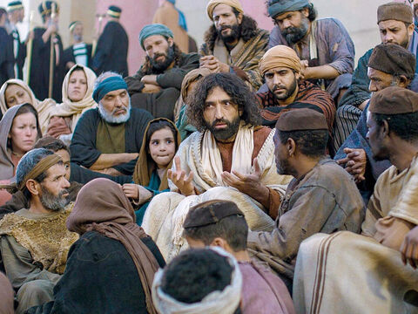
LOOKING BACK LIVING FORWARD: Continuing the prophetic legacy
PROPHETS: JESUS
FORTHTELLING
repent
the Kingdom is here
believe in me
ethical teachings
PICTURE OF JESUS TEACHING from FREE BIBLE IMAGES

Slide 15
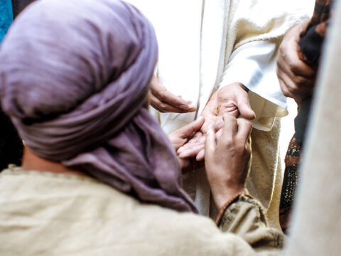
LOOKING BACK LIVING FORWARD: Continuing the prophetic legacy
PROPHETS: JESUS
FORTHTELLING
repent
the Kingdom is here
believe in me
ethical teachings
FORETELLING
death, burial, resurrection and return
PICTURE OF JESUS WITH THOMAS from FREE BIBLE IMAGES

Slide 16
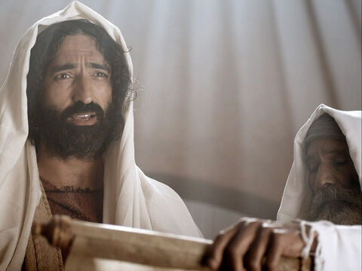
LOOKING BACK LIVING FORWARD: Continuing the prophetic legacy
JESUS: A prophet who fulfilled prophecy
LUKE 4:14-21
300+ OT prophecies
(maybe 465 & even 527)
JESUS READING FROM ISAIAH 61 IN NAZARETH from FREE BIBLE IMAGES

Slide 17
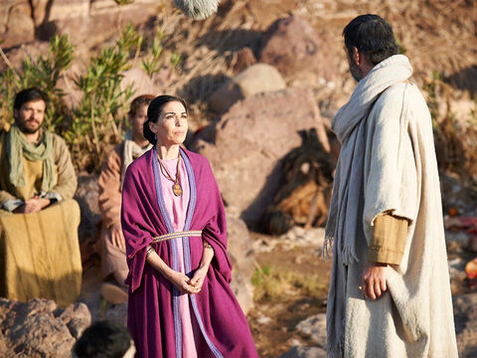
Believers in Jesus continue the prophetic legacy IN THE WORLD by showing and telling the good news about him (FORTHTELLING)
We are therefore Christ’s ambassadors, as though God were making his appeal through us. We implore you on Christ’s behalf: Be reconciled to God.
[2 CORINTHIANS 5:20]
ACTS 16:11-15
LOOKING BACK LIVING FORWARD:
PAUL SPEAKING WITH LYDIA
from FREE BIBLE IMAGES

Slide 18
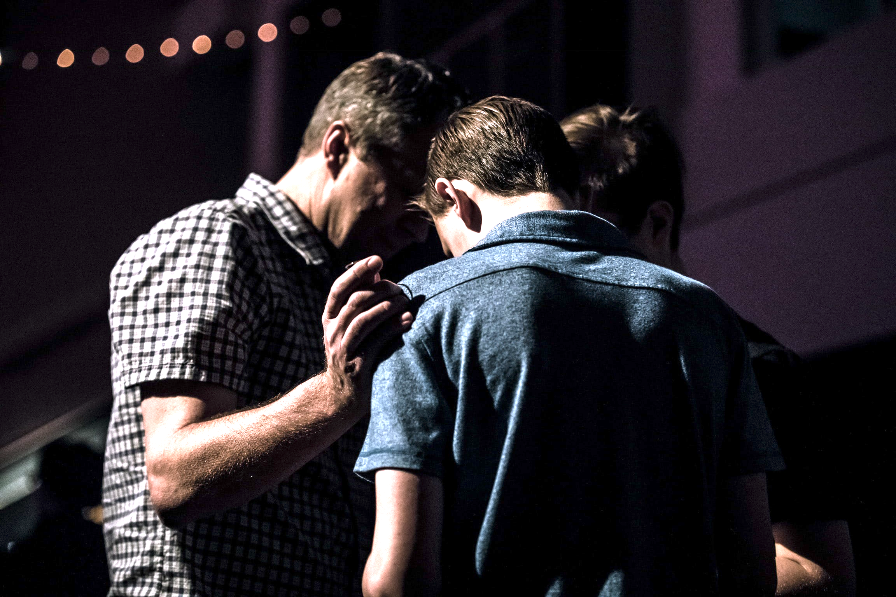
Believers in Jesus continue the prophetic legacy IN THE CHURCH by spiritually encouraging others (FORTHTELLING)
the one who prophesies speaks to people for their strengthening, encouraging and comfort. Anyone who speaks in a tongue edifies themselves, but the one who prophesies edifies the church.
[1 CORINTHIANS 14:13-14]
PHOTO BY JACK SHARP ON UNSPLASH
LOOKING BACK LIVING FORWARD

Slide 19
Believers in Jesus continue the prophetic legacy IN THE CHURCH by spiritually encouraging others (FORTHTELLING)
Do not let any unwholesome talk come out of your mouths, but only what is helpful for building others up according to their needs, that it may benefit those who listen.
[EPHESIANS 4:29]
PHOTO BY JACK SHARP ON UNSPLASH
LOOKING BACK LIVING FORWARD

Slide 20
Believers in Jesus continue the prophetic legacy IN THE CHURCH by spiritually encouraging others (FORTHTELLING)
speaking the truth in love, we will grow to become in every respect the mature body of him who is the head, that is, Christ.
[EPHESIANS 4:15]
PHOTO BY JACK SHARP ON UNSPLASH
LOOKING BACK LIVING FORWARD

Slide 21
Believers in Jesus may sometimes continue the prophetic legacy IN THE CHURCH by speaking about people’s futures insightfully (FORETELLING)
∴
they must pass communal testing
presumption
and
personal agendas
The spirits of prophets are subject to the control of prophets
[1 CORINTHIANS 14:32]
DANGER
LOOKING BACK LIVING FORWARD

Slide 22
Continuing the prophetic legacy
Be –
sensitive to God’s Spirit and his word
alert to your context
thoughtful about how to act in the context
ready to speak the good news at any time
willing to do whatever God asks, whatever the cost
prepared for challenges
open to accountability
LOOKING BACK LIVING FORWARD

Slide 23
Looking Back Living Forward
Lessons for today, learned from Old Testament Prophets
Continuing the Prophetic Legacy
LUKE 4:14-24

